Slide 2
WELCOME

Slide 3
Vehicle Service Contracts

Slide 4

iA American Has Options
Walkaway/retro programs
Reinsurance program options
Higher mileage/expanded eligibility programs
Technology coverage program
Limited, Certified and Lifetime options
Wrap Programs

Slide 5


iA American Has Options
  STANDARD VEHICLE SERVICE CONTRACT

Slide 6
  STANDARD VEHICLE SERVICE CONTRACT
Vehicle Eligibility
Vehicle Eligibility
New
Current plus 4 model years up to 50,000 miles
Pre-Owned
Current plus 9 model years up to 100,000 miles
New
Current plus 4 model years up to 60,000 miles
Pre-Owned
Current plus 12 model years up to 125,000 miles

Slide 7
  STANDARD VEHICLE SERVICE CONTRACT
Terms
Terms
New
45 term options up to
120 months 150,000 miles
Pre-Owned
6 term options up to
60 months 60,000 miles
New
60 term options up to
96 months 125,000 miles
Pre-Owned
10 term options 12/18, 24/30, 36/42, 48/45 up to 60 months 60,000 miles

Slide 8
  STANDARD VEHICLE SERVICE CONTRACT
Deductible
Deductible
$0
$50, $50V
$100, $100V
$200, $200V
$400, $400V
$0
$50
$100, $100V
$200
$400

Slide 9
  STANDARD VEHICLE SERVICE CONTRACT
Coverages
Coverages
Bronze
Silver
Gold
Platinum (Exclusionary)
Wrap
Certified Wrap
Powertrain
Classic
High-Tech
Elite (Exclusionary)
Wrap
Diesel Wrap
Certified Wrap

Slide 10
  STANDARD VEHICLE SERVICE CONTRACT
Options & Surcharges
Options & Surcharges
1 ton / 10 cyl / 12 cyl
Diesel
4WD/AWD
Turbocharger/supercharger
Dual rear wheels
Lifted/lowered vehicles (8 inches)
Autonomous driving systems
Travel expense reimbursement upgrade
Commercial / Rideshare inboarded
Snow removal inboarded
Emissions coverage
Remanufactured parts
Cover part cause of loss
Non-covered part cause of loss
First day rental
Rideshare
Suspension/tire (6 inches)
Commercial use
Snow removal

Slide 11
  STANDARD VEHICLE SERVICE CONTRACT
Ancillary Benefits
Ancillary Benefits
Trip interruption
  $150 a day up to $450
Emergency roadside
  $100 per occurrence
Rental
  $60 a day up to $300
  Plus 4 additional days for parts delay
Towing
  $100 per occurrence
Lockout service
  $50 per occurrence
Trip interruption
  $75 a day up to $225
Emergency roadside (Includes Lockout) – Optional Coverage
  $100 per occurrence
Rental (Transportation expense reimbursement)
  $30 a day up to $150
  Upgrade $60 to $300
Towing
  $100 per occurrence

Slide 12
  STANDARD VEHICLE SERVICE CONTRACT
Competitive Advantages
Competitive Advantages
Surcharge options make this contract very customizable
Works in conjunction with our FIP program
Coverages for hybrid all-electric, PHEV (plug-in hybrid), and fuel-cell vehicles
If within 50 miles, all repairs or replacements under this service contract must be performed by the selling company’s licensed repair facility

Slide 13
  STANDARD VEHICLE SERVICE CONTRACT
Reinsurance Advantages
Reinsurance Advantages
FIP allows access to unearned premium
Surcharge options allow up to $290 in additional reserve with low losses
Priced to a 40% loss ratio
Present Value of Future Benefits allows access to unearned premium
Reinsurance cession statements available on the first of the month
Priced to a 60% loss ratio
Ability to target a lower loss ratio

Slide 14

  XTENDED VEHICLE SERVICE CONTRACT

Slide 15
  XTENDED VEHICLE SERVICE CONTRACT
Vehicle Eligibility
Vehicle Eligibility
New
Current plus 6 model years up to 60,000 miles
Pre-Owned
Current plus 14 model years up to 150,000 miles
Pre-Owned
Current plus 20 model years up to 200,000 miles

Slide 16
  XTENDED VEHICLE SERVICE CONTRACT
Terms
Terms
New
55 term options up to
120 months 150,000 miles
Pre-Owned
15 term options up to
60 months 60,000 miles
Pre-Owned
37 term options up to
60 months 60,000 miles

Slide 17
  XTENDED VEHICLE SERVICE CONTRACT
Deductible
Deductible
$0
$100, $100V
$200
$50
$100, $100V
$250
$500

Slide 18
  XTENDED VEHICLE SERVICE CONTRACT
Coverages
Coverages
Powertrain
Standard
Preferred
Ultimate (exclusionary)
Rates are wrap rates.
Level 1
Level 2
Level 3
Level 4 (exclusionary)

Slide 19
  XTENDED VEHICLE SERVICE CONTRACT
Options & Surcharges
Options & Surcharges
Dual rear wheels
10-cylinder engine
12-cylinder engine
Cadillac Northstar pre-2002
Cadillac Northstar 2002 and newer
4WD/AWD
1 ton
Diesel engine
Turbocharger/supercharger components
Autonomous driving systems
Travel expense reimbursement upgrade
Seals and gaskets 125K – 150K
Lifted/lowered vehicle up to 8 inches
Commercial use not available
Emissions coverage
Remanufactured parts
Rideshare
Cover part cause of loss
Non-covered part cause of loss
First day rental
Automatic on program
Suspension/tire (6 inches)
Commercial use

Slide 20
  XTENDED VEHICLE SERVICE CONTRACT
Ancillary Benefits
Ancillary Benefits
Trip interruption
  $150 a day up to $450
Emergency roadside
  $100 per occurrence
Rental
  $60 a day up to $300
  Plus 4 additional days for parts delay
Towing
  $100 per occurrence
Lockout service
  $50 per occurrence
Trip interruption
  $75 a day up to $225
Emergency roadside (Includes Lockout) – Optional Coverage
  $100 per occurrence
Rental (Transportation expense reimbursement) $30 a day up to $150
  Upgrade $60 a day up to $300
Towing
  $100 per occurrence

Slide 21
  XTENDED VEHICLE SERVICE CONTRACT
Competitive Advantages
Competitive Advantages
Surcharge options make this contract very customizable
Franchise and non-franchise rate card
Loss ratio set at 85%
Coverages for hybrid all-electric, PHEV (plug in hybrid), and fuel-cell vehicles
If within 50 miles, all repairs or replacements under this service contract must be performed by the selling company’s licensed repair facility

Slide 22
  XTENDED VEHICLE SERVICE CONTRACT
Reinsurance Advantages
Reinsurance Advantages
Currently not a reinsurable program
Present Value of Future Benefits allows access to unearned premium
Reinsurance cession statements available on the first of the month
Priced to 80% loss ratio
Ability to target a lower loss ratio

Slide 23
  ENHANCED CARE LEASE OPTIONS

Slide 24
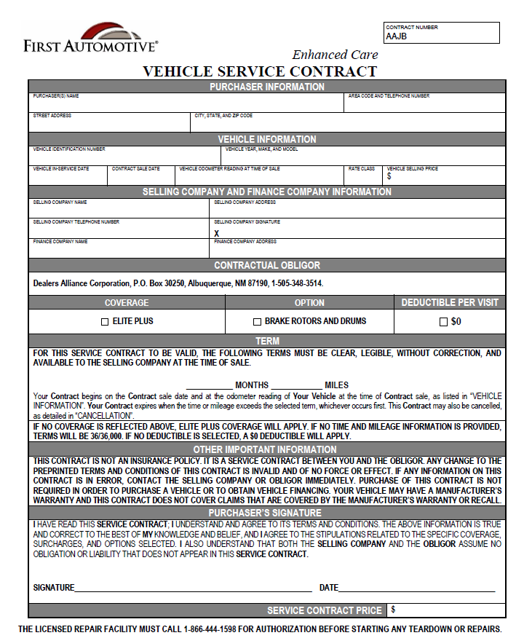
Enhanced Care – Eligibility
New vehicles up to one year old with less than 7,500 miles at the time of sale
Leased vehicles are also eligible for this program

Slide 25

Enhanced Care – Terms
24 months – 24,000 miles
24 months – 30,000 miles
36 months – 36,000 miles
36 months – 45,000 miles
39 months – 39,000 miles
39 months – 50,000 miles

Slide 26
Enhanced Care – Terms
42 months – 50,000 miles
48 months – 48,000 miles
48 months – 60,000 miles
60 months – 60,000 miles

Slide 27
Enhanced Care – Wear and Tear Items
Brake pad coverage – One Set
Battery coverage – One
Headlamp coverage - Unlimited
Belts and hoses coverage - Unlimited
Windshield wiper blade coverage – One Set
Electrical coverage - Unlimited
Wheel alignment coverage – One
Optional – Brake Rotors and Drums - Unlimited

Slide 28
Enhanced Care – Ancillary Benefits
Rental benefit – $35 a day up to 10 days
Emergency road service benefit
  Lockout assistance
  Flat tire assistance
  Battery jump start
  Towing
  Fuel, oil, fluid, and water delivery

Slide 29
Enhanced Care – Approval
This contract is approved in all states except
  Florida
  Alaska
  State-specific forms for CA and WA

Slide 30


Slide 31

Classic Care – Terms
24 months – 24,000 miles
24 months – 30,000 miles
27 months – 27,000 miles
27 months – 33,750 miles
36 months – 36,000 miles
36 months – 45,000 miles

Slide 32
Classic Care – Terms
39 months – 39,000 miles
39 months – 48,750 miles
42 months – 42,000 miles
42 months – 52,500 miles
48 months – 48,000 miles
48 months – 50,000 miles
48 months – 60,000 miles

Slide 33
Classic Care
Battery - One
Belts and hoses - Unlimited
Brake pads – One Set
Brake rotors – One Set
Electrical items- Unlimited
Wheel alignment – One
Windshield wiper blades – One Set
Headlamps - Unlimited
Diagnostic coverage
Fluid coverage – Unlimited
  (With Covered Repair)

Slide 34
Classic Care – Additional Benefits
Rental benefit – $60 a day up to 5 days
  Plus four additional days for parts delay
Trip interruption benefit – $200 up to 3 days
Towing benefit – $100 per occurrence
Emergency road service benefit – mechanical first aid, tire service, battery service, delivery service
Lockout benefit– $100 per occurrence
Paintless dent repair coverage (PDR) – unlimited
Windshield repair coverage– unlimited
Key/key fob replacement benefit – two keys, no cost cap

Slide 35
Classic Care– State Approvals
This contract is approved in all states except:
CT, FL, GA, KS, ME, MT, ND, PA, SC, SD, VT, WI, WY, AK
Lender approvals
  Ally – all states except the ones not available
  Sentinel Mazda – AZ, CA, NV, OR, UT
  Sentinel Toyota – AZ, CA, NV, OR, UT

Slide 36


Slide 37
Additional VSC Options
Autotech Protect
Designed for customers who turn down a traditional VSC
Three stated levels
Covers consumer-facing items in vehicle
Low-cost option
Time only terms

Slide 38
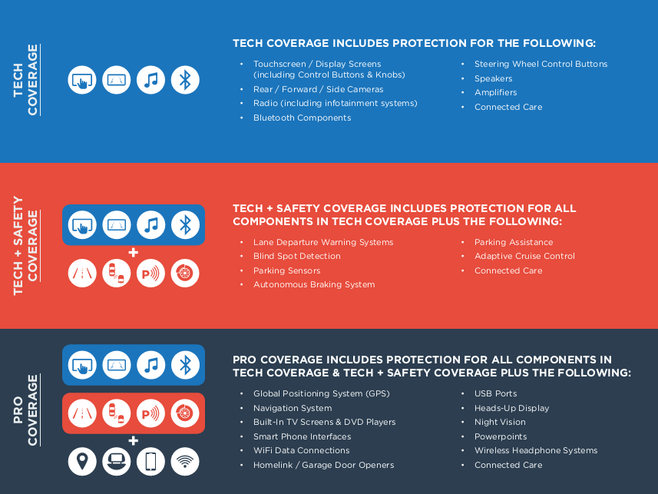

Slide 39



Slide 40
Lifetime Warranties
Lifetime Limited Warranty (Mag Moss)
Provides customer with engine or powertrain coverage for as long as he/she owns the vehicle
Customer must maintain vehicle in accordance with manufacturer’s recommendations
Service can occur anywhere
Lifetime Loyalty
Same coverage as the Limited Warranty
Dealer can set maintenance intervals
Customer must come back to issuing dealer for service

Slide 41
Lifetime Warranties
Lifetime Program Options:
Limited Warranty or Loyalty
Engine or Powertrain
New only, used only, combo
Eligibility:
  New one year old, up to 12,000 miles, depending on contract
  Used up to 10 years, old up to 100,000 miles on contract
Deductibles:
  $0, $100, $200, reducing and disappearing
Reinsurable
Coverage on electric vehicles on some programs

Slide 42


Slide 43
Certified Limited Warranties
Same coverage as the manufacturer:
  Example: Ford/Asian – Powertrain coverage for 84 months and 100,000 miles, starting from ISD and 0 miles
  Exclusionary coverage for 12 months and 12,000 miles, from VPD and odometer on VPD
Thorough ~200-point inspection must be completed and retained on file (does not need to be remitted)
Upsell into Standard and Millennium VSC wraps

Slide 44
Certified Limited Warranties
Create your own dealer certified program
Ford store that sells a lot of pre-owned Hondas?
Utilize a “blended” certified program that is not limited to one manufacturer

Slide 45


Slide 46
Customized Short-Term Limited Warranties
Standard 3/3, 6/6, 12/12 terms
  Current plus 15 model years, up to 200k miles standard
  Multiple classing options
  Fully customizable coverage:
    Powertrain standard
    Exclusionary
    Aggregate limits of liability
    Powertrain plus AC
    Powertrain plus roadside
Fully insured – reinsurable

Slide 47
Franchise or non-franchise dealer who does not want to reinsure?
  STANDARD VEHICLE SERVICE CONTRACT
  XTENDED VEHICLE SERVICE CONTRACT

Slide 48
Dealers who want to maximize reinsurance
  STANDARD VEHICLE SERVICE CONTRACT
  XTENDED VEHICLE SERVICE CONTRACT

Slide 49
Dealers who want to reinsure but want a higher in-store profit in finance
  STANDARD VEHICLE SERVICE CONTRACT
  XTENDED VEHICLE SERVICE CONTRACT

Slide 50
Franchise dealer who may or may not want to reinsure and who has a high lease penetration…
  ENHANCED CARE LEASE OPTIONS

Slide 51
Door openers
  ENHANCED CARE LEASE OPTIONS
  XTENDED VEHICLE SERVICE CONTRACT

Slide 52
Q&A

